Slide 1
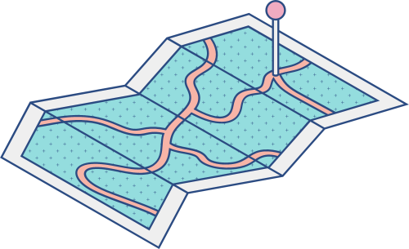





A QUICK INFORMATION GUIDE
M?obile Store System
A look at the importance of technology
in teaching and learning

Slide 2
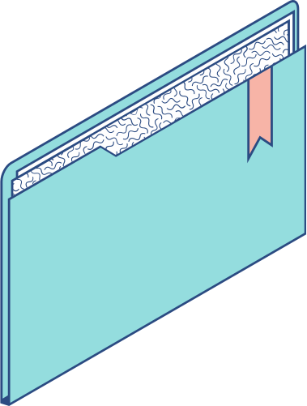
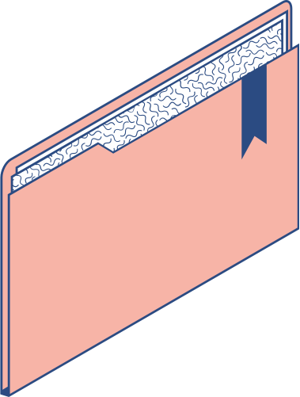
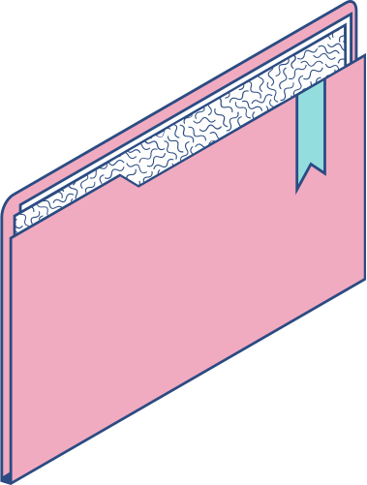
Agenda
KEY TOPICS DISCUSSED IN THIS PRESENTATION
Talk about product scope
Function Requirements required in the application
Components of Non-Funtion Requirements
Product features and (optional) architecture style will be considered

Slide 3

The Impact of Mobile Store System
This app help user can shopping mobile online in the website , the admin will manage all account and product.

Slide 4
As a user we can
1
2
3
4
5
CREAT ACCOUNT FOR USER
LOGIN TO APP
ADD TO CART
REMOVE CART
SEND FEEDBACK
6
7
8
GET VOUCHER DISCOUNT
SEARCH PRODUCT
VIEW DETAIL PRODUCT

Slide 5
As a Admin we can
1
2
3
4
5
CREAT NEW PRODUCT
VIEW ALL OF USER
UPDATE PRODUCT
UPDATE USER INFORMATION
LOGIN

Slide 6
NON-FUNCTIONAL REQUIREMENTS
REFERENCES:
HTTPS://WWW.GURU99.COM/NON-FUNCTIONAL-REQUIREMENT-TYPE-EXAMPLE.HTML
HTTPS://WINATALENT.COM/BLOG/2020/05/WHAT-ARE-NON-FUNCTIONAL-REQUIREMENTS-TYPES-AND-EXAMPLES/N
Performance:
Usability:
- Fast loading times
- Instantaneous search results
- Simple & intuitive interface
- Sensible website navigation
- Conform to modern web design standards
Portability & Compatibility:
Security:
- Compatible with all modern browsers (Edge Chromium, Chrome, Firefox,...)
- Responsive web front-end scaling to different screen sizes
- Only the users are allowed to view & modify their own password
Localisation:
- English with possible Vietnamese support

Slide 7

ARCHITECTURE STYLES
The Model-View-Controller (MVC) is an architectural pattern that separates an application into three main logical components: the model, the view, and the controller. Each of these components are built to handle specific development aspects of an application. MVC is one of the most frequently used industry-standard web development framework to create scalable and extensible project

Slide 8

THANK YOU!
Do you have any questions?

